Slide 1


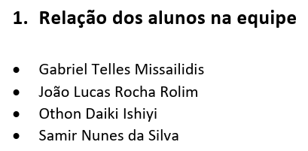
Infinity - Money Manager Web
Sprint 0 - CSI-29
Professor:
Inaldo Capistrano Costa

Slide 2
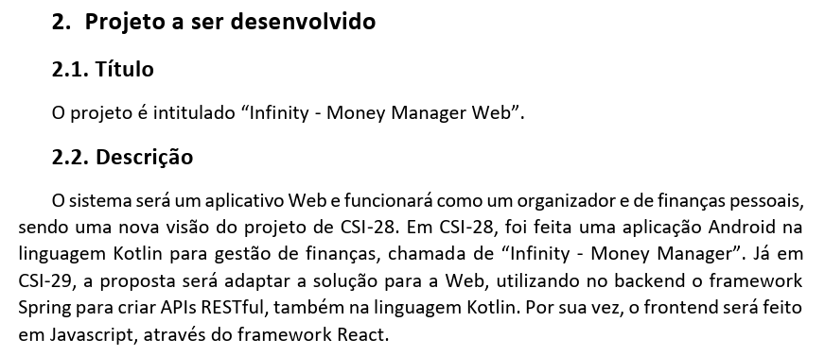
Infinity - Money Manager Web

Slide 3
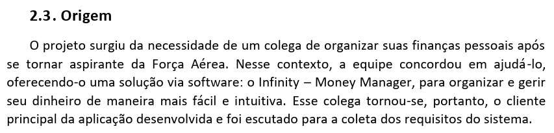
Infinity - Money Manager Web

Slide 4

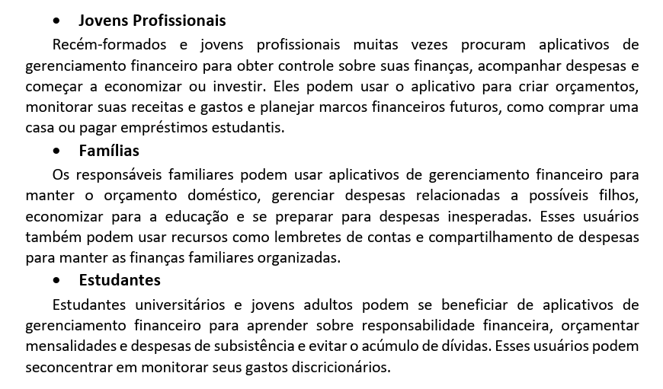
Infinity - Money Manager Web

Slide 5
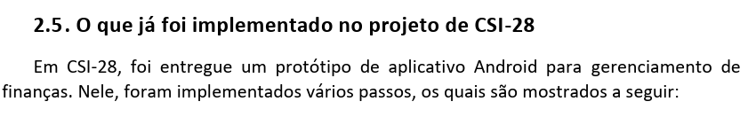
Infinity - Money Manager Web

Slide 6
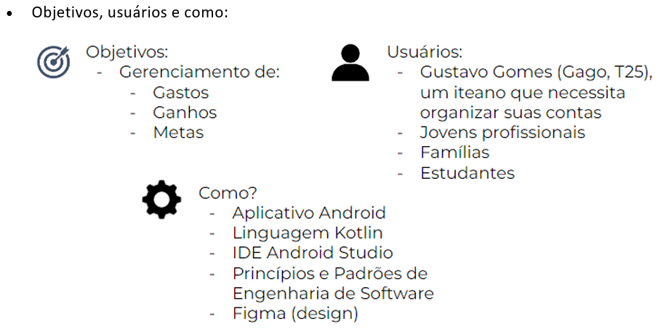
Infinity - Money Manager Web

Slide 7
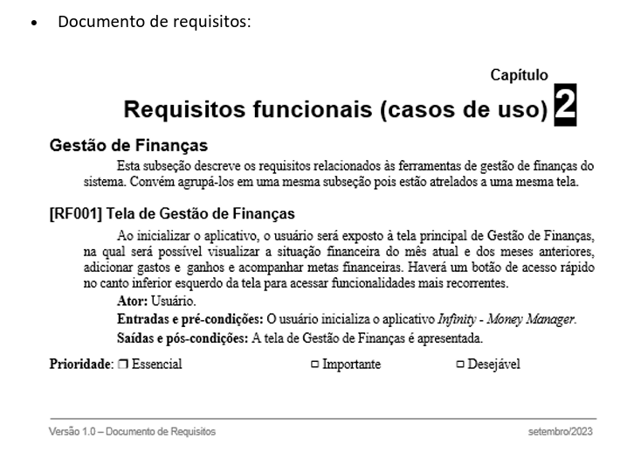
Infinity - Money Manager Web

Slide 8
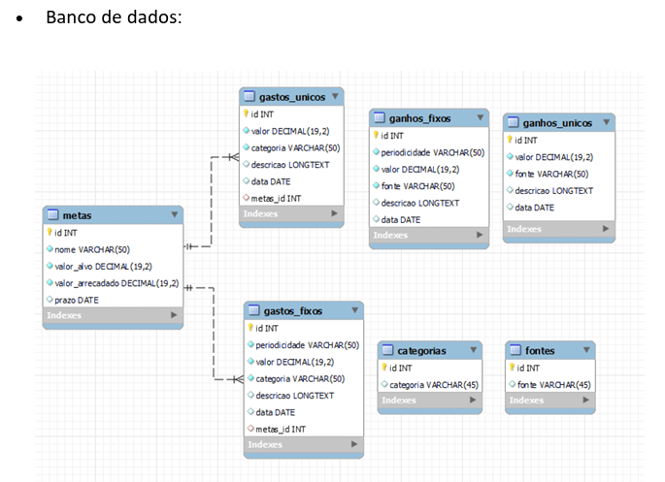
Infinity - Money Manager Web

Slide 9
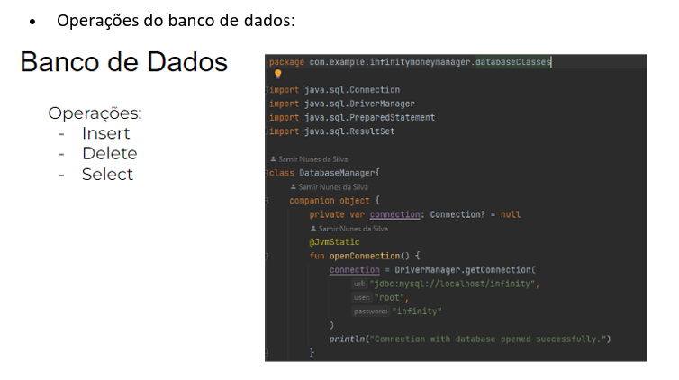
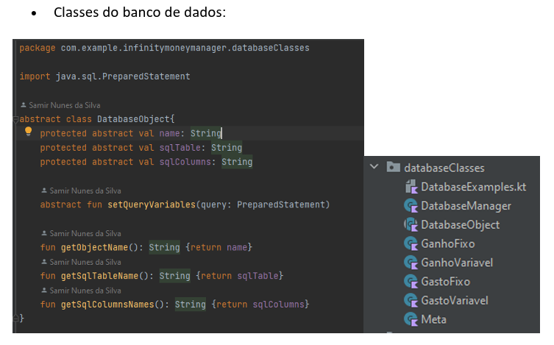
Infinity - Money Manager Web

Slide 10
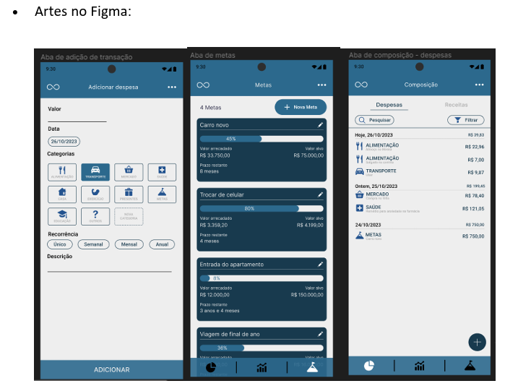
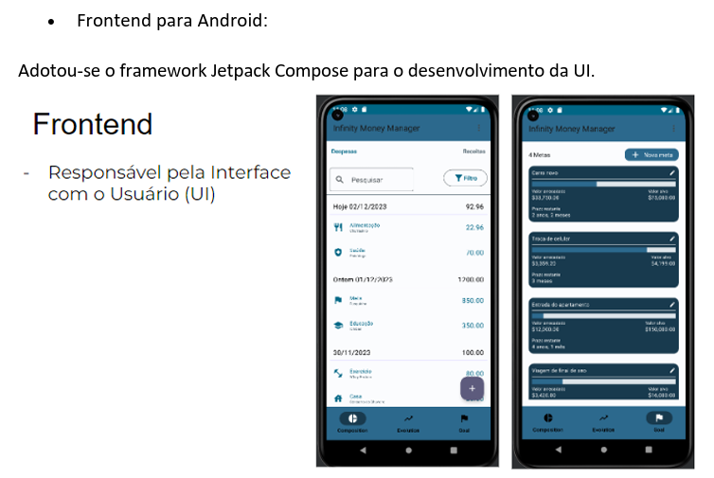
Infinity - Money Manager Web

Slide 11
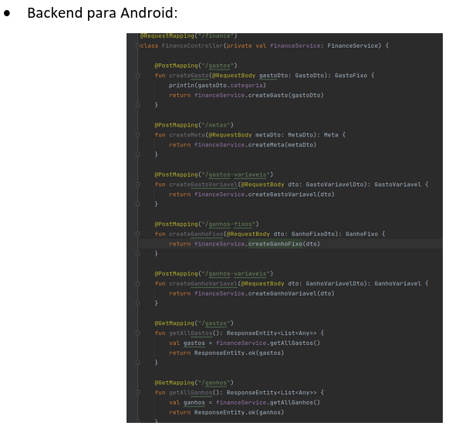
Infinity - Money Manager Web

Slide 12
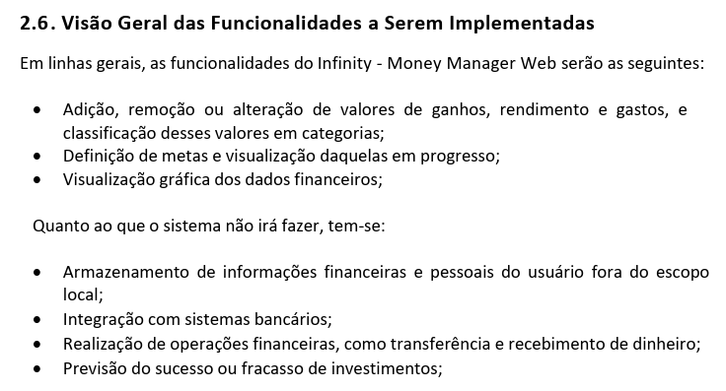
Infinity - Money Manager Web

Slide 13

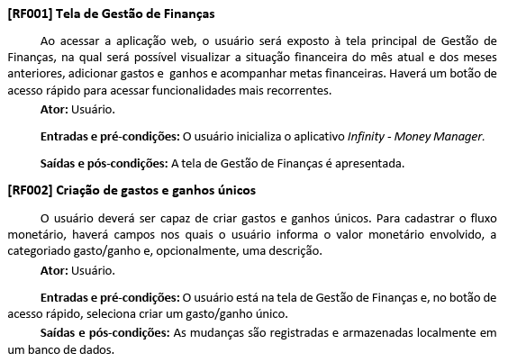
Infinity - Money Manager Web

Slide 14
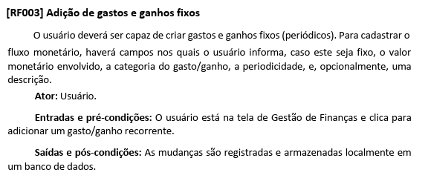
Infinity - Money Manager Web

Slide 15
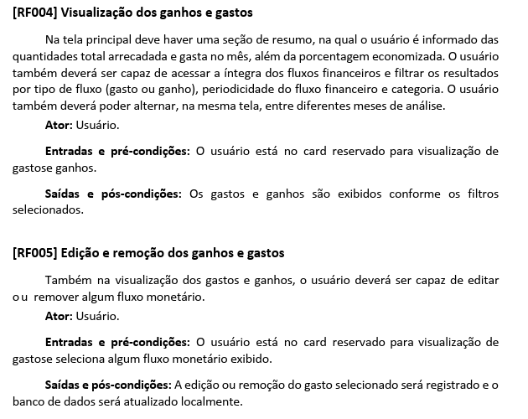
Infinity - Money Manager Web

Slide 16
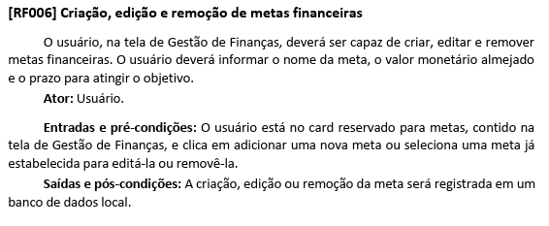
Infinity - Money Manager Web

Slide 17
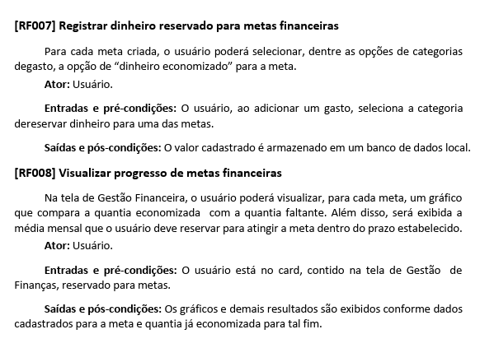
Infinity - Money Manager Web

Slide 18
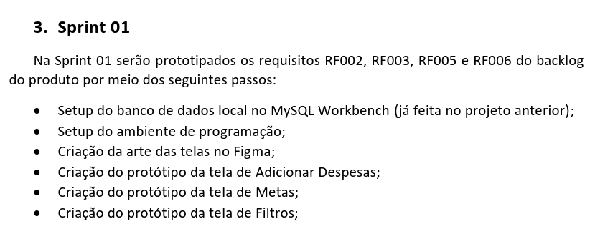
Infinity - Money Manager Web

Slide 19
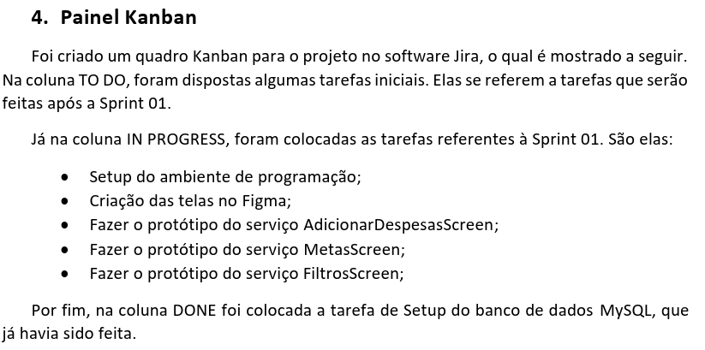
Infinity - Money Manager Web

Slide 20
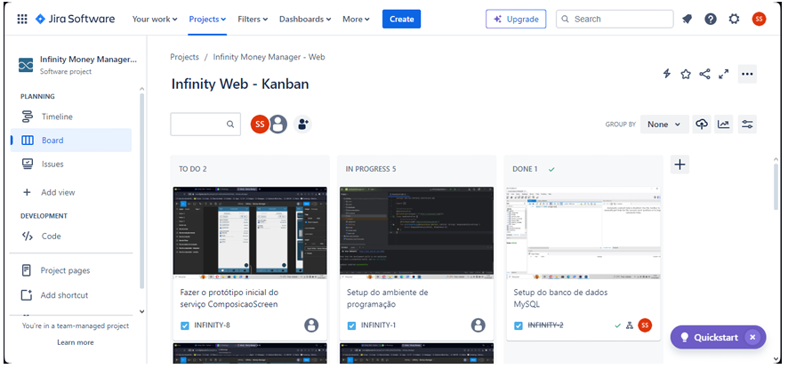
Infinity - Money Manager Web

Slide 21
Obrigado!

